Slide 1


Slide 2

Diabetic Retinopathy Classification Using Deep Learning Techniques
Semester Fall 2022

Slide 3
Project code: ZN-CS-2025-146
Project Advisors: Dr. Hussam Ali (Internal)
Dr. Muhammad Fayyaz (External)
Project Manager: Prof. Dr. Muhammad Ilyas
Project Team: Zarnain Javed (Group Leader)
Roll no: BSCS51F22S022
Member 2: Narmeen Ayub
Roll no: BSCS51F22S011
Department of Computer Science and Artificial Intelligence
University Of Sargodha
Fall, 2022

Slide 4
Outline
Introduction
Literature Review
Research Gaps
Research Challenges
Research Objectives
Proposed Methodology
Results and Discussions
References

Slide 5
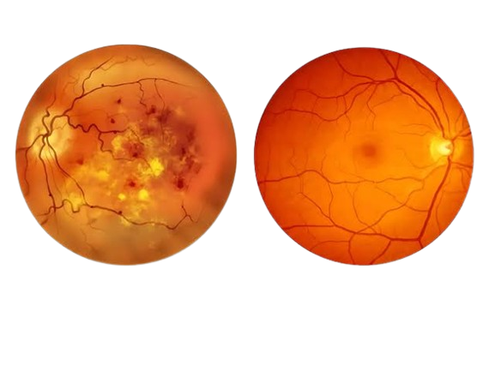
Introduction
DR is one of the most serious complications of diabetes.
Its leading cause of blindness worldwide.
It develops when high blood sugar damages the small blood vessels in the retina.
Normal eye Diabetic Retina

Slide 6
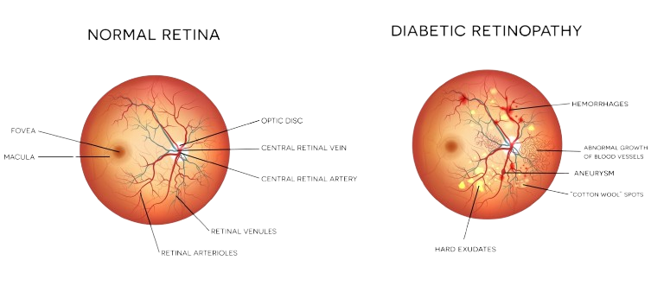
Introduction
Damaged blood vessels may leak fluid or blood .
If left untreated, DR can progress to cause vision loss.
Roughly, one-third of the 463 million people worldwide who have diabetes are affected by it [1].

Slide 7
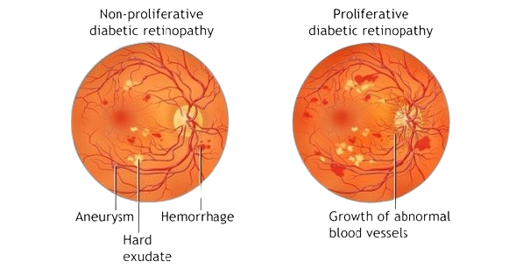
Introduction
The International Diabetes Federation (IDF) projects that there will be a significant increase in the global diabetes population from roughly 552 million in 2035 to 642 million in 2040 [2].
It has been seen that 25 % of all diabetics develop this complication after 10 years of developing Diabetes.
50 % develop it after 20 years of developing diabetes.

Slide 8
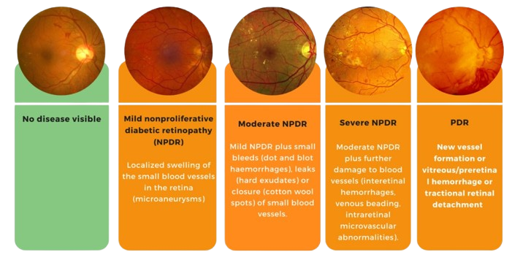
Stages of Diabetic Retinopathy

Slide 9
Approaches used in Classification
Deep Learning:
Learn patterns from many examples.
Hybrid Models:
Combine methods to get better results.
Vision Transformers:
Use attention to see the whole image.

Slide 10
Literature Review of Deep Learning Approaches
Table 1: Deep Learning Approaches for Diabetic Retinopathy (2023-2025)
Ref | Title | Method/Approaches | Dataset | Acc (%)
[3] | DR Classification Using Hybrid Color-Based CLAHE and Blood Vessel in Deep CNN | BV segmentation + CLAHE-TH enhancement, fused features into VGG19 / InceptionV3 classifier. | Kaggle DR detection dataset | 96%
[4] | A DL based model for diabetic retinopathy grading | Retinopathy Severity Grading Network (RSG-NET) CNN with preprocessing and augmentation. | Messidor-1 | 99%
[5] | A Lightweight Robust Deep Learning Model for DR classification | Improved base CNN through hyperparameter tuning to create RetNet-10. | APTOS, Messidor2, and IDRiD (combined) | 98.65%
[6] | Automatic Diabetic Retinopathy Diagnosis Using Adaptive Fine-Tuned CNN | Two-stage CNN fine-tuning with PCA and Gradient Boosting. | E-ophtha(training), EyePACS, Messidor. | 95%

Slide 11
Literature Review of Deep Learning Approaches
Table 1: Deep Learning Approaches for Diabetic Retinopathy (2023-2025)
Ref | Title | Method/Approaches | Dataset | Acc (%)
[7] | Early Detection of Diabetic Retinopathy Through the Integration of Deep Learning Models | 5-layer CNN with Conv2D, max-pooling and softmax for DR classification. | APTOS (training), Messidor2, IDRiD (testing) | 95.27%
[8] | Early Detection and Severity Classification of Diabetic Retinopathy Using CNN | Lightweight CNN + CLAHE + Augmentation + GAP | APTOS | 97.5%
[9] | Enhancing Early Detection of DR Through the Integration of Deep Learning Models and Explainable AI | Custom CNN with convolution, max-pooling, and dense layers using ReLU, compared against transfer learning models. | APTOS | 95.27%

Slide 12
Literature Review of Hybrid Approaches
Table 2: Hybrid Approaches for Diabetic Retinopathy (2023-2025)
Ref | Title | Method/Approaches | Dataset | Acc (%)
[10] | Hybrid CNN Model for Automatic DR Classification | combines ResNet50 and InceptionV3 features, fuses them, and classifies DR | Kaggle DR dataset | 96.85%
[11] | Fusion of heterogeneous fundus data | VGG19 + ResNet50V2 / Hybrid Deep Learning | Aptos/Messidor-2/DDR/IDRID | 91.82%
[12] | Lesion based DR detection using hybrid deep learning model | Hybrid CNN (ResNet-16 + Google-Net) with APSO + ML Classifiers | EyePACS | 94%
[13] | HybridFusionNet: Deep Learning for Multi-Stage Diabetic Retinopathy Detection | hybrid deep learning approach combining Self-Attention Network (SAN)+Vision Transformer (Vit) | Kaggle Diabetic Retinopathy Detection dataset | 99%

Slide 13
Literature Review of Hybrid Approaches
Table 2: Hybrid Approaches for Diabetic Retinopathy (2023-2025)
Ref | Title | Method/Approaches | Dataset | Acc (%)
[14] | DR classification through dual attention mechanism | CNN with spatial and channel dual attention modules combined with trans former encoder layers for enhanced feature extraction | APTOS /EyePACS | 95.7%
[15] | Diabetic Retinopathy Detection from Fundus Images of the Eye Using Hybrid DL Features | Transfer Learning-based Hybrid GoogleNet and ResNet-18 features with SVM Classifier | APTOS | 89.29%
[16] | Early detection and classification of DR by transfer learning of NASNet-large and ResNet-50 CNN | Transfer learning with ResNet-50+ GCE (green channel extraction) + CLAHE | APTOS | 91.14%
[17] | A Hybrid Model for Diabetic Retinopathy Classification Using Retinal Fundus Images | EfficientNetV2+SVM | APTOS | 97.26%
[18] | Hybrid deep learning framework for early detection | CNN+RNN(LSTM)/Feature fusion | DRIVE/EyePACS | N/R

Slide 14
Literature Review of Vision Transformer Approaches
Table 3: Vision Transformer Approaches for Diabetic Retinopathy (2023-2025)
Ref | Title | Method/Approaches | Dataset | Acc (%)
[13] | Hybrid Fusion-Net: Deep Learning for Multi-Stage Diabetic Retinopathy Detection | hybrid deep learning approach combining Self-Attention Network (SAN)+Vision Transformer (Vit) | Kaggle Diabetic Retinopathy Detection dataset | 99%
[19] | Feature attention module on CNN for DR detection | CNN with feature attention modules and transformer-inspired positional encoding for highlighting lesion regions | APTOS | 95.70%
[20] | DL powered segmentation and classification using transfer learning | Hybrid model combining U-Net seg mentation, pretrained CNN, and Vision Transformer (ViT) for feature fusion and classification | Kaggle DR Dataset | 89.1%

Slide 15
Research Gaps
Existing DR research faces significant challenges due to limited dataset diversity, class imbalance, and the difficulty of distinguishing subtle differences between adjacent DR stages. Limited representation of variations in color, contrast, resolution, and imaging devices in training data results in lower accuracy and poor generalization of the models. Additionally, the unequal distribution of DR severity levels particularly the scarcity of advanced cases introduces bias and reduces reliable classification across all classes. These issues are further compounded by the subtle visual differences between early and intermediate DR stages, making precise classification.

Slide 16
Research Challenges
Data Imbalance: Most datasets contain more normal images than severe DR cases.
Computational Constraints: DR tools must work on low-resource devices.
Image Quality : Retinal images vary due to different cameras.

Slide 17
Research Objectives
The objectives are the following:
• To develop efficient deep learning model.
• To handle class imbalance in DR datasets.
• To provide Feature representation for overall retinal patterns .
The main goal of this research is to develop robust AI-based solution that is mostly required in both urban hospitals and rural healthcare centers

Slide 18
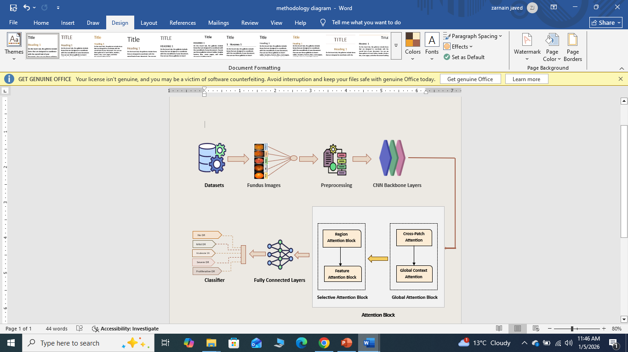
Figure 1: Workflow of Proposed Methodology

Slide 19
Proposed Methodology
This Proposed methodology consists of four steps such as data preparation, proposed hybrid DL architecture (CNN backbone, multi-stage attention block, feature fusion, and fully connected layer), classifier. The details related to these steps are given in the subsequent sections.
Data Preparation
Data Augmentation: Flips, rotations for class balancing and dataset diversity.
Super-Resolution Enhancement: As a preprocessing step we will apply SRGAN (Super-Resolution Generative Adversarial Network) to enhance low resolution fundus images, improving visibility.

Slide 20
Proposed Methodology
2. Tentative Proposed Hybrid DL Architecture
CNN backbone: This step will be used for feature extraction. In this regard, we will apply VGG54 to extract features from fundus images.
Multi-stage Attention Block: This block refines the extracted features by focusing on important regions. It helps the model better distinguish different DR stages. Multistage attention module with four attention blocks is proposed to improve efficiency.

Slide 21
Proposed Methodology
Cross-Patch Attention It will model relationships between different patches of the fundus image. Helps detect patterns spread across regions.
Global Context Captures overall retinal structure and long-range dependencies. Useful for DR stage understanding.
Region Attention Focuses on important retinal regions (lesions like microaneurysms, exudates). Suppresses background.
Feature Attention Block Reweights important feature channels (e.g., texture, color, vessels). Enhances discriminative features.

Slide 22
Proposed Methodology
Feature Fusion: Combination of outputs from multiple layers of CNN
d) Fully connected layers: The refined features are converted into a compact representation. This layer prepares the features for final classification.
3.Classifier:
The classifier predicts the diabetic retinopathy stage. The output includes
No DR, Mild, Moderate, Severe, and Proliferative DR.

Slide 23
Results and Discussions
This section will present the experimental setup and results obtained after implementing proposed methodology for DR classification. The evaluation of each task is described separately in subsequent sections.
Tentative Datasets:
Table 4: Statistics of Applied Dataset
Datasets | Image type | No of images | Challenges
APTOS | Retinal Fundus Images | 3,662 images | Small dataset size, Imbalance classes, Lesion Similarity
EyePACS | Retinal Fundus Images | 88,702 images | Class imbalance, low resolution, Noise, illumination variations

Slide 24
Results and Discussions
1.Evaluation Metrics
Accuracy: Proportion of correctly answered questions.
Sensitivity: Ability to correctly identify positive cases.
Specificity: Ability to correctly identify negative cases.
2.Experimental Setup
The experimental settings cover Adam (Adaptive Moment Estimation), learning rate schedule, activation functions, momentum, batch size, and epochs. We will apply K-fold as cross validation method. Moreover, Grad-CAM and lesion-specific saliency maps are used to highlight critical retinal regions influencing predictions.

Slide 25
Conclusion
This research proposes a deep learning approach for diabetic retinopathy classification using attention modules. The model is expected to focus on clinically important retinal regions. By incorporating attention mechanisms, the proposed methodology aims to improve classification accuracy and interpretability for reliable diabetic retinopathy detection.

Slide 26
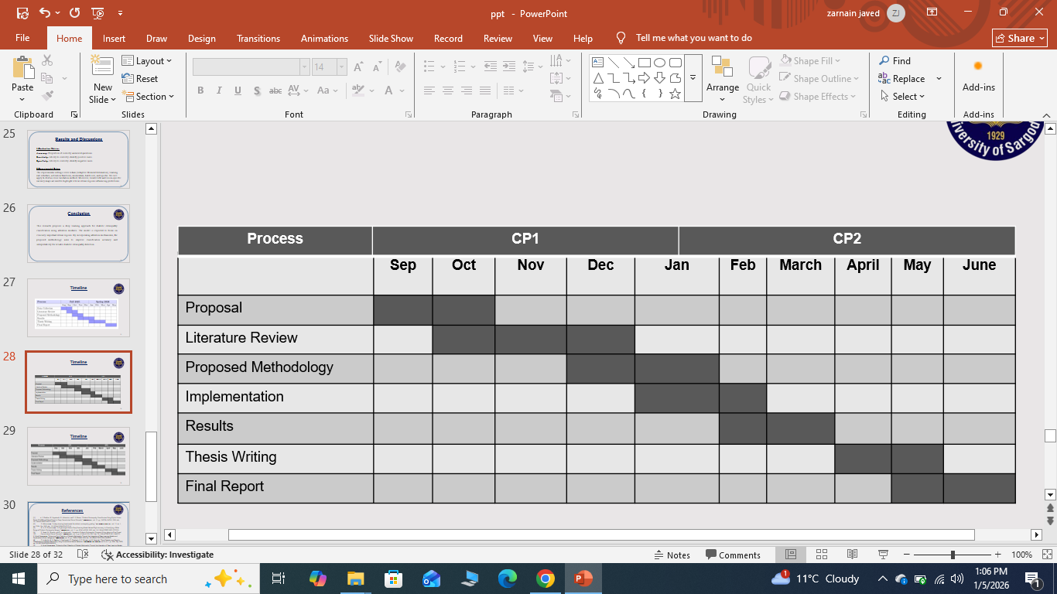
Timeline

Slide 27
References
[1] W. L. Alyoubi, W. M. Shalash, and M. F. Abulkhair, “Diabetic retinopathy detection through deep learning techniques: A review,” Informatics Med. Unlocked, vol. 20, p. 100377, Jan. 2020, doi: 10.1016/j.imu.2020.100377.
[2] R. Rajalakshmi, R. Subashini, R. M. Anjana, and V. Mohan, “Automated diabetic retinopathy detection in smartphone-based fundus photography using artificial intelligence,” Eye (Lond)., vol. 32, no. 6, pp. 1138–1144, Jun. 2018, doi: 10.1038/S41433-018-0064-9.
[3]. A. J. Kadhim, H. Seyedarabi, R. Afrouzian, and F. S. Hasan, “Diabetic Retinopathy Classification Using Hybrid Color-Based CLAHE and Blood Vessel in Deep Convolution Neural Network,” IEEE Access, vol. 12, pp. 194750–194761, 2024, doi: 10.1109/ACCESS.2024.3519361.
[4] S. Akhtar et al., “A deep learning based model for diabetic retinopathy grading,” Sci. Reports 2025 151, vol. 15, no. 1, pp. 3763-, Jan. 2025, doi: 10.1038/s41598-025-87171-9.
[5] M. A. K. Raiaan et al., “A Lightweight Robust Deep Learning Model Gained High Accuracy in Classifying a Wide Range of Diabetic Retinopathy Images,” IEEE Access, vol. 11, pp. 42361–42388, 2023, doi: 10.1109/ACCESS.2023.3272228.
[6] F. Saeed, M. Hussain, and H. A. Aboalsamh, “Automatic Diabetic Retinopathy Diagnosis Using Adaptive Fine-Tuned
[7] Convolutional Neural Network,” IEEE Access, vol. 9, pp. 41344–41359, 2021, doi: 10.1109/ACCESS.2021.3065273.
K. Ahnaf Alavee et al., “Enhancing Early Detection of Diabetic Retinopathy Through the Integration of Deep Learning Models and Explainable Artificial Intelligence,” IEEE Access, vol. 12, pp. 73950–73969, 2024, doi: 10.1109/ACCESS.2024.3405570.
[8] S. A. Karthik, M. N. Geetha, K. Prabhavathi, D. Shashank, K. P. Suhaas, and M. Narender, “Early Detection and Severity Classification of Diabetic Retinopathy Using Convolutional Neural Networks,” SN Comput. Sci. 2025 67, vol. 6, no. 7, pp. 819-, Sep. 2025, doi: 10.1007/S42979-025-04361-Y.

Slide 28
References
[9] K. Ahnaf Alavee et al., “Enhancing Early Detection of Diabetic Retinopathy Through the Integration of Deep Learning Models and Explainable Artificial Intelligence,” IEEE Access, vol. 12, pp. 73950–73969, 2024, doi: 10.1109/ACCESS.2024.3405570.
[10]A Hybrid Convolutional Neural Network Model for Automatic Diabetic Retinopathy Classification From Fundus Images | IEEE Journals & Magazine | IEEE Xplore.” Accessed: Nov. 05, 2025. [Online]. Available: https://ieeexplore.ieee.org/document/10142165
[11] S. R. Refat et al., “VR-FuseNet: A Fusion of Heterogeneous Fundus Data and Explainable Deep Network for Diabetic Retinopathy Classification,” Jun. 2025, Accessed: Nov. 04, 2025. [Online]. Available: http://arxiv.org/abs/2504.21464
[12] A. Jabbar et al., “A Lesion-Based Diabetic Retinopathy Detection Through Hybrid Deep Learning Model,” IEEE Access, vol. 12, pp. 40019–40036, 2024, doi: 10.1109/ACCESS.2024.3373467.
[13] ]A. Shukla, S. Tiwari, and A. Jain, “HybridFusionNet: Deep Learning for Multi-Stage Diabetic Retinopathy Detection,” Technol. 2024, Vol. 12, Page 256, vol. 12, no. 12, p. 256, Dec. 2024, doi: 10.3390/TECHNOLOGIES12120256.
[14] A. Hannan, Z. Mahmood, R. Qureshi, and H. Ali, “Enhancing Diabetic Retinopathy Classification Accuracy through Dual Attention Mechanism in Deep Learning,” Comput. Methods Biomech. Biomed. Eng. Imaging Vis., vol. 13, no. 1, Jul. 2025, doi: 10.1080/21681163.2025.2539079.
[15] M. M. Butt, D. N. F. A. Iskandar, S. E. Abdelhamid, G. Latif, and R. Alghazo, “Diabetic Retinopathy Detection from Fundus Images of the Eye Using Hybrid Deep Learning Features,” Diagnostics (Basel, Switzerland), vol. 12, no. 7, Jul. 2022, doi: 10.3390/DIAGNOSTICS12071607.
[16] S. Vallukappully, I. van der Linde, and A. Chakraborty, “Early detection and classification of diabetic retinopathy by transfer learning of NASNet-large and ResNet-50 convolutional neural networks,” Informatics Med. Unlocked, vol. 58, p. 101688, Jan. 2025, doi: 10.1016/J.IMU.2025.101688.

Slide 29
References
[17] K. V. Naveen, B. N. Anoop, K. S. Siju, M. K. Kar, and V. Venugopal, “EffNet-SVM: A Hybrid Model for Diabetic Retinopathy Classification Using Retinal Fundus Images,” IEEE Access, vol. 13, pp. 79793–79804, 2025, doi: 10.1109/ACCESS.2025.3566073.
[18] M. Sushith, A. Sathiya, V. Kalaipoonguzhali, and V. Sathya, “A hybrid deep learning framework for early detection of diabetic retinopathy using retinal fundus images,” Sci. Reports 2025 151, vol. 15, no. 1, pp. 1–31, Apr. 2025, doi: 10.1038/s41598-025-99309-w.
[19] “Introducing Feature Attention Module on Convolutional Neural Network for Diabetic Retinopathy Detection | Request PDF.” Accessed: Dec. 21, 2025. [Online]. Available: https://www.researchgate.net/publication/372961726_Introducing_Feature_Attention_Module_on_Convolutional_Neural_Network_for_Diabetic_Retinopathy_Detection
[20] M. S. Harisha, A. A. Bhosale, and M. Narender, “Deep learning-powered segmentation and classification of diabetic retinopathy for enhanced diagnostic precision,” Artif. Intell. Heal. 2024, 1(4), 30-42, vol. 1, no. 4, pp. 30–42, Sep. 2024, doi: 10.36922/AIH.2783.

